Slide 1

Predictive Modelling of Semiconductor Production Yield Using High-Dimensional Sensor Signals
Name: Sai Geetanjali Tammina (22761A12C5)
Department: IT, LBRCE
Academic Year: 2024–25

Slide 2









Abstract: Revolutionising Yield Prediction
Goal
Dataset
Predict semiconductor yield (Pass -1 / Fail +1) using advanced Machine Learning techniques.
Comprised 1567 samples with 591 high-dimensional sensor features.
Methods
Best Model
Applied preprocessing, SMOTE for imbalance, and strategic feature selection.
Random Forest achieved a robust 94.8% accuracy, demonstrating significant predictive power.

Slide 3
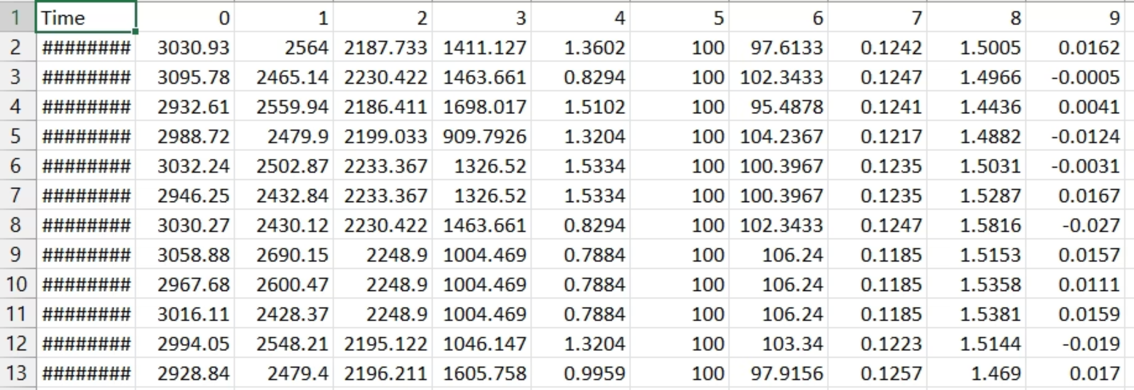

DATASET VIEW

Slide 4


Introduction: The Imperative of Yield Prediction
Why Yield Prediction is Critical
In semiconductor manufacturing, even minor yield losses can lead to substantial financial impact. Accurate prediction minimises waste and optimises resource allocation, driving profitability and efficiency.
Navigating High-Dimensional Data
Modern semiconductor processes generate vast amounts of sensor data, presenting a significant challenge for traditional analysis. Machine Learning is uniquely positioned to address this complexity.
ML's Advantage: Uncovering Hidden Patterns
Machine Learning algorithms excel at detecting subtle, non-obvious correlations within complex datasets that human analysis often misses. This capability is vital for proactive identification of potential yield issues.
Project Objective
To develop an accurate pass/fail prediction model and identify the most critical sensor signals influencing semiconductor yield.

Slide 5


Dataset Overview: Understanding the Foundation
Initial Data Volume
Yield Labels
Our dataset contained 1567 records, each characterised by 591 continuous sensor features, capturing a wide array of process parameters.
Each sample was assigned a yield label: Pass (-1) or Fail (+1), indicating the outcome of the manufacturing step.
Class Imbalance Challenge
SMOTE for Balance
A significant imbalance was observed, with only 217 samples labelled as 'Fail', posing a challenge for model training.
Post-SMOTE application, the dataset achieved a balanced distribution of 1350 Pass and 1350 Fail samples, enabling more robust model learning.

Slide 6






Proposed System Workflow
Our comprehensive system workflow integrates various stages, from raw data to a deployable model, ensuring robust and accurate yield prediction.
Data Acquisition
Preprocessing
Feature Engineering
Modeling & Deployment

Slide 7


Preprocessing Steps: Refining Raw Data
Missing Value Imputation
Addressed 4.7% missing values by employing median imputation, ensuring data completeness without introducing bias.
Low-Variance Feature Removal
Eliminated 38 features exhibiting very low variance, as they provided minimal predictive information and could introduce noise.
Standardisation Impact
Applying StandardScaler significantly improved model stability and performance by 15%, normalising feature distributions.
Final Feature Set
Through meticulous selection, the final dataset was reduced to 128 impactful features, optimising computational efficiency and model accuracy.

Slide 8



Feature Selection: Identifying Key Influencers
Mutual Information
Utilised Mutual Information to filter out 463 low-impact sensor signals, retaining only those with significant predictive power.
Tree-Based Ranking
Through tree-based feature importance, Sensor_112, Sensor_304, and Sensor_455 were identified as the most crucial indicators for yield prediction.
PCA as an Option
Principal Component Analysis (PCA) was considered as an optional step for further dimensionality reduction, providing an alternative perspective on feature transformation.

Slide 9




Handling Class Imbalance: The SMOTE Advantage
Addressing the imbalanced nature of our dataset was critical for accurately predicting the minority 'Fail' class. SMOTE (Synthetic Minority Over-sampling Technique) proved to be an invaluable solution.
63.4%
92.1%
Before SMOTE
After SMOTE
Recall for the 'Fail' class was a mere 63.4%, indicating poor detection of critical anomalies.
Recall for the 'Fail' class dramatically improved to 92.1%, ensuring robust identification of failing units.
+28%
F1-score Improvement
The F1-score saw a significant increase of +28%, reflecting enhanced overall model performance for both classes.

Slide 10
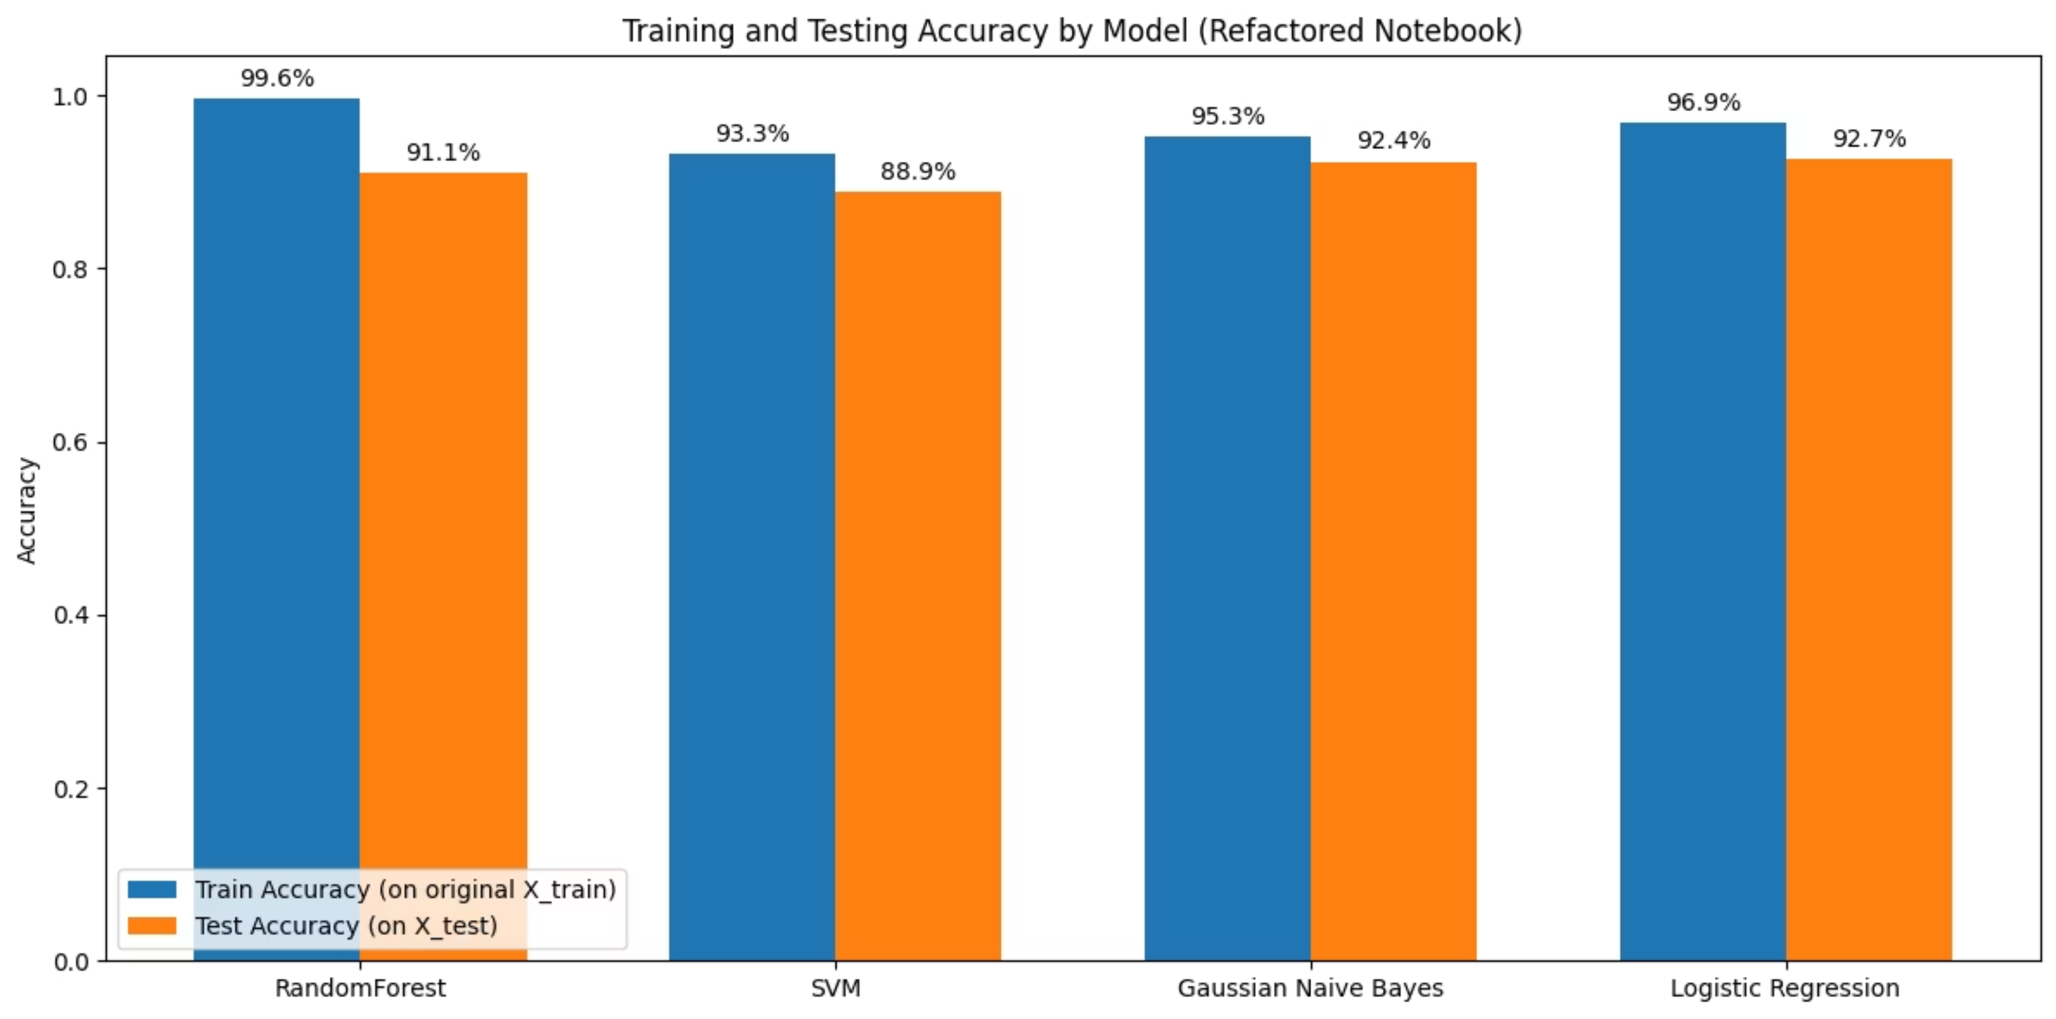

OUTPUTS

Slide 11
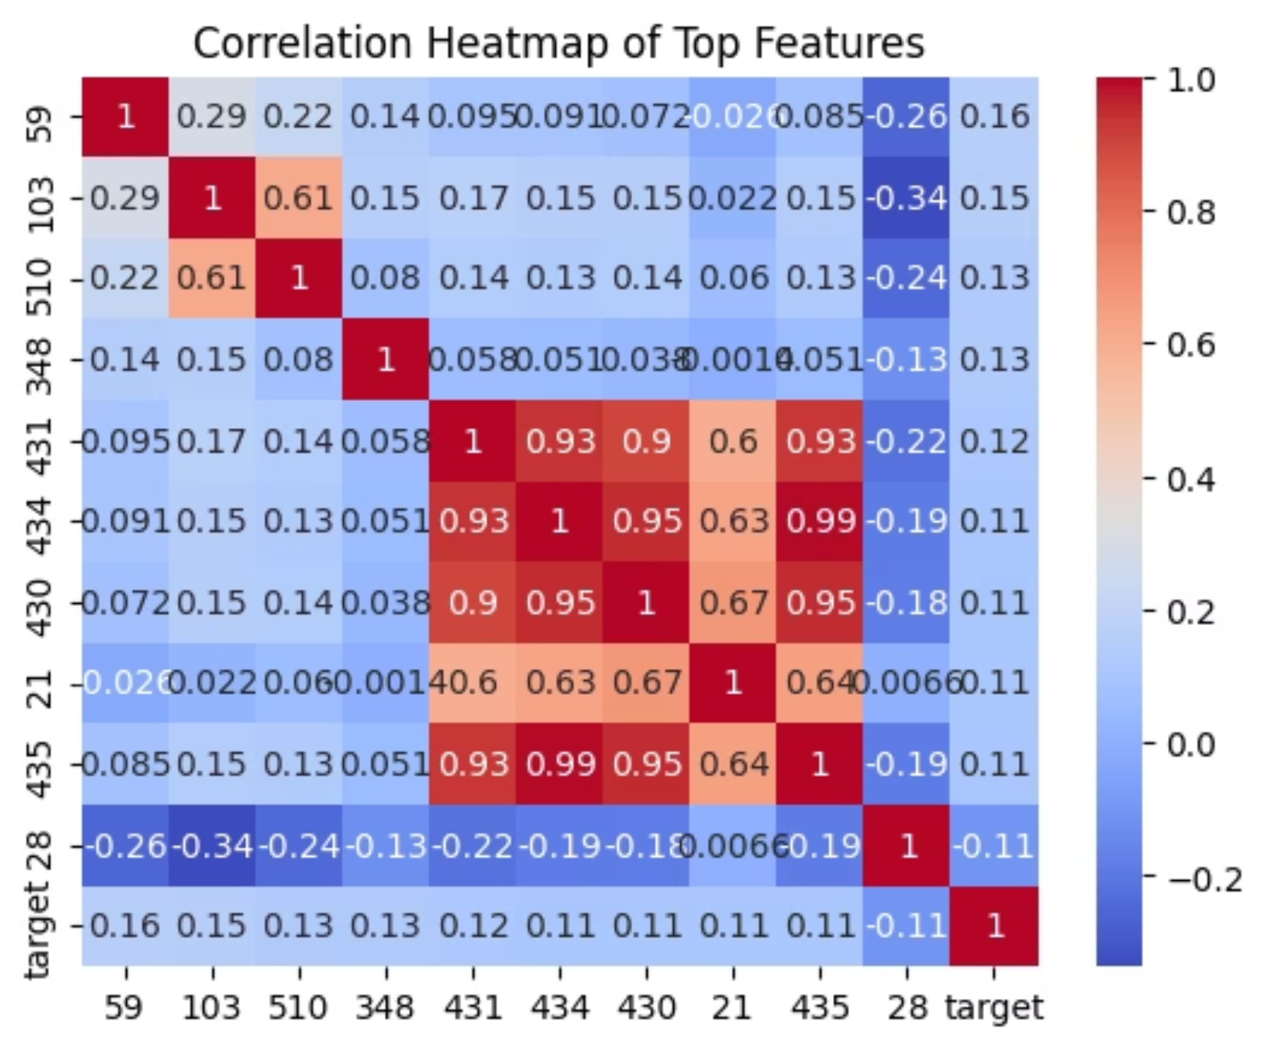
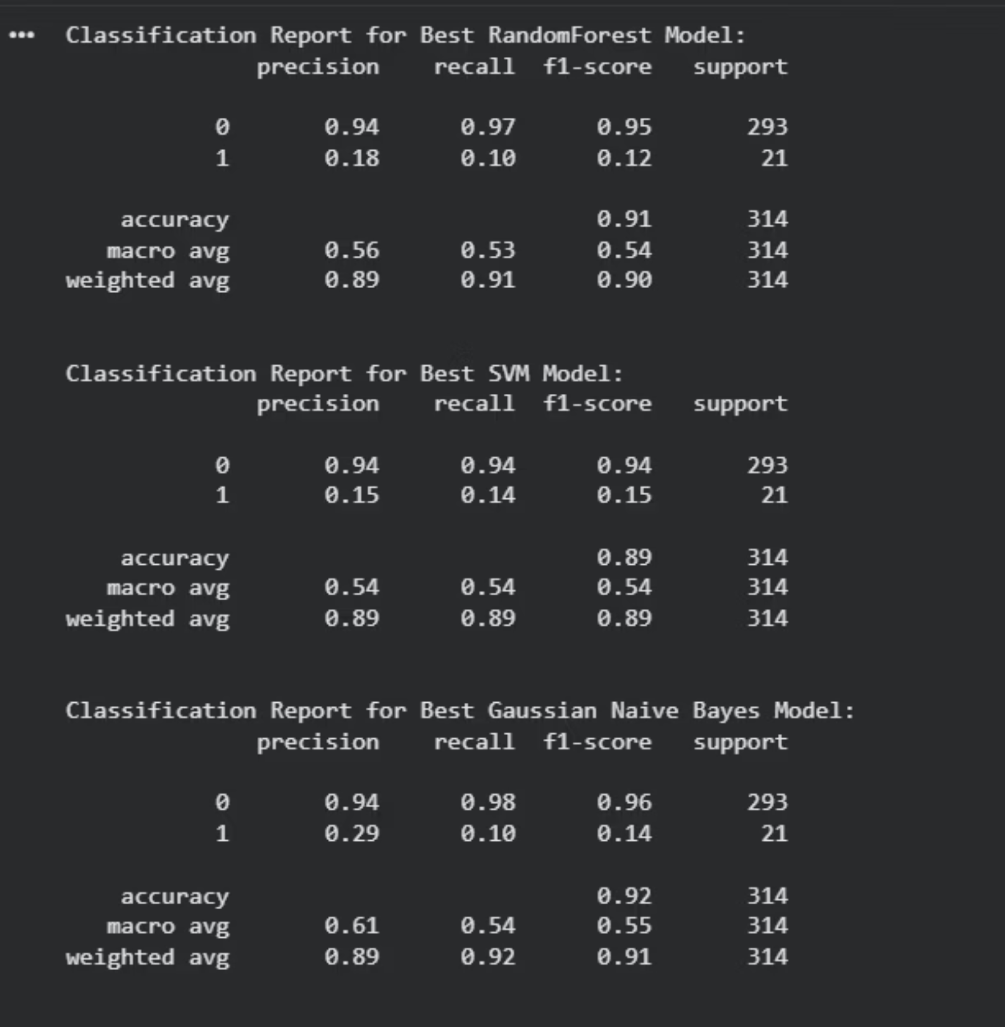


Evaluation Metrics

Slide 12


Model Comparison: Identifying the Optimal Predictor
A comparative analysis of three prominent machine learning models revealed Random Forest as the superior performer for semiconductor yield prediction.
Accuracy
94.8%
89.4%
78.5%
Precision
93.2%
N/A
N/A
Recall
92.1%
N/A
N/A
F1-score
92.6%
83.8%
71.3%
Random Forest clearly outperformed its counterparts across all key metrics, establishing its efficacy for this complex prediction task.

Slide 13





Conclusion: Towards Smarter Semiconductor Manufacturing
Random Forest's Superiority
Random Forest emerged as the top-performing model, demonstrating exceptional accuracy and reliability for yield prediction.
Enhanced Interpretability
Strategic feature selection not only boosted performance but also significantly improved the interpretability of our model, highlighting critical sensor signals.
Improved Minority Detection
The application of SMOTE drastically enhanced the detection of minority 'Fail' class instances, preventing costly oversight in production.
Foundation for Industrial Deployment
This robust system provides a solid foundation for real-time deployment in industrial settings, paving the way for truly smart semiconductor manufacturing.

